Slide 1
Artificial Neural Networks
What are they, when should I use one, and how do I use one?

Slide 2
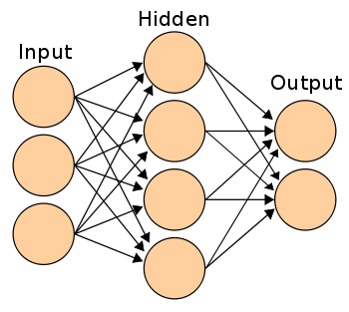
What are they?

Slide 3
When should I use one?
No clear, well understood solution
Brute force takes too long

Slide 4
When should I use one?
Artificial Neural Networks (ANNs) are good at..
Classification
Prediction
Pattern recognition
Optimization

Slide 5
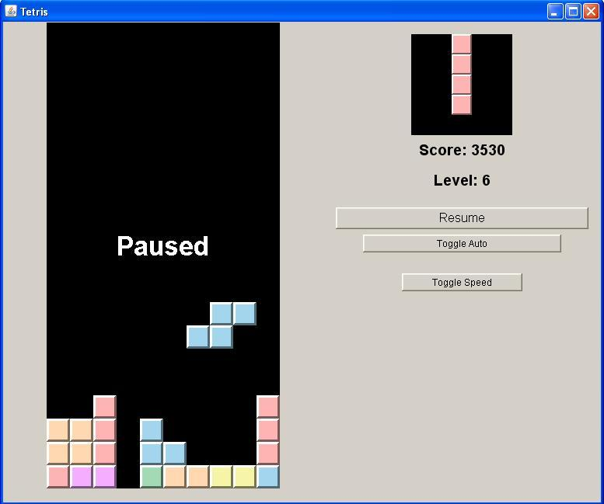
When should I use one?
No clear, well understood solution
Brute force takes too long
5.624x10^60 game states
5,624,000,000,000,000,000, 000,000,000, 000,000,000,000, 000,000,000,000, 000,000,000, 000,000,000,000,000

Slide 6
How do I use one?
Structure
Training

Slide 7
How do I (me) use one? (Structure)
Artificial Neural Networks (ANNs) are good at..
Classification
Prediction
Pattern recognition
Optimization

Slide 8

How do I (me) use one? (Structure)
Shrink
20 x 10
10 x 10
99.9 (27 more 9’s)%
(still over 2^100)

Slide 9
How do I (me) use one? (Structure)
Represent inputs
Black = 0
Yellow = 1
Red = 2

Slide 10

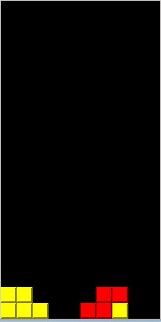
How do I (me) use one? (Structure)
BAD
GOOD!
-1
1

Slide 11
How do I (me) use one? (Training)
~6,000
0.000000000000000000000000004%

Slide 12
No Convergence…
75-100+% error

Slide 13
Time for a change..

Slide 14
New Inputs
100 inputs..
8
Height
# ‘squares’ touching edge
# ‘squares’ touching other pieces (to the sides)
# holes (directly) beneath piece
Total # holes beneath piece
Width/height (of piece)
# “squares’ touching floor/piece below
# lines cleared

Slide 15
New Inputs
99.9(18 more 9’s)%
2^100 → 83,520,000
~1,500 training cases
0.000018% all possible

Slide 16
Convergence!
10-30% error

Slide 17
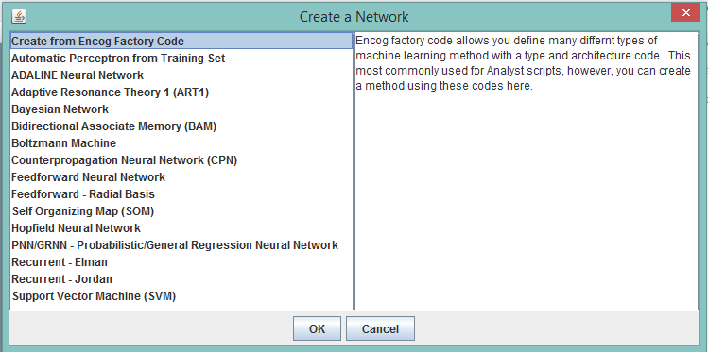
How do I (me) use one? (Structure)

Slide 18
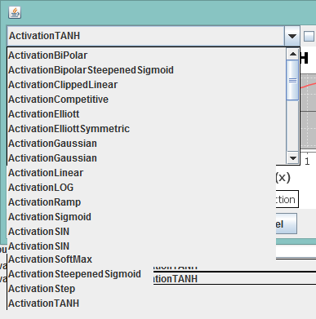
How do I (me) use one? (Structure)
Notes:
Hidden nodes are important

Slide 19
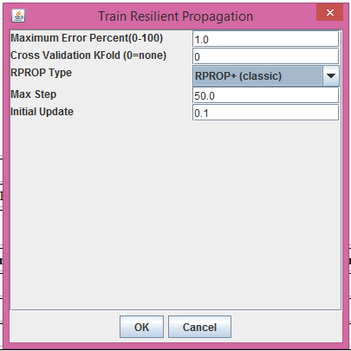
How do I (me) use one? (Training)
Notes:
Hidden nodes are important

Slide 20
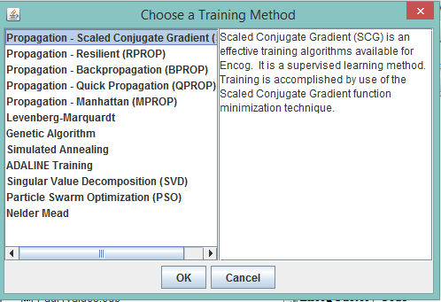
How do I (me) use one? (Training)
Notes:
Hidden nodes are important

Slide 21
How do I (me) use one? (Training)
Notes:
Hidden nodes are important

Slide 22
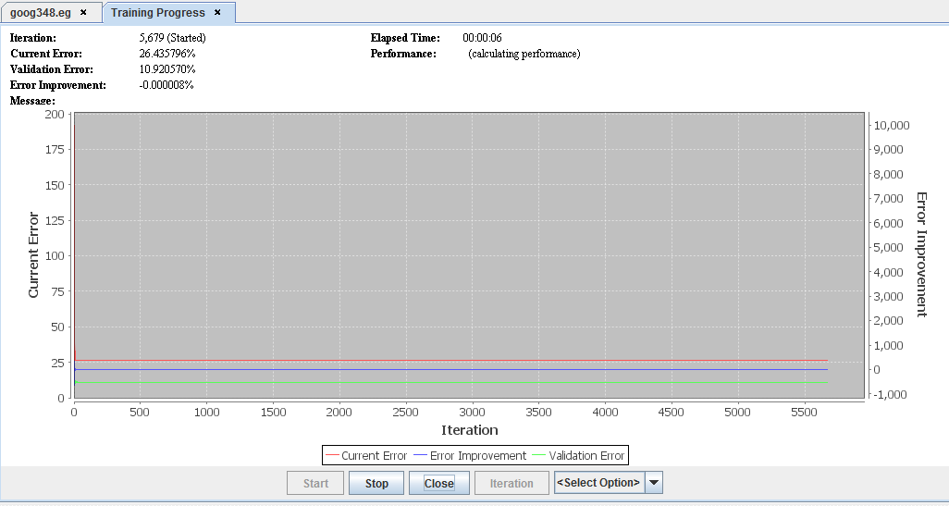
How do I (me) use one? (Training)
Notes:
Hidden nodes are important

Slide 24
Resources
www.heatonresearch.com

